Slide 1



Gold Stock Prediction
GLOBAL ACADEMY OF TECHNOLOGY
Department of Information Science & Engineering
Mini Project Presentation
Guided By: Prof.Pathanjali C
Presented By: Sinchana S (1GA22IS154)
Vishma A S (1GA22IS186)
Notes:
We designed this template so that each member of the project team has a set of slides with its own theme where he/she can present their research. Members, here’s how you add a new slide to just your set:
Mark where you want to add the slide: Select an existing one in the Thumbnails pane, click the New Slide button, then choose a layout.
The new slide gets the same theme as the previous one you selected.
Careful! Don’t annoy your fellow presenters by accidentally changing their themes. That can happen if you choose a theme Variant from the Design tab, which changes all of the slides in your presentation to that look.

Slide 2
Agenda
Overview / Background
Problem Statement
Motivation
Objectives
Literature Review
Project Requirements
System Architecture
Expected Outcome

Slide 3
Overview / Background
1. Historical Significance:
- Gold is a valuable commodity and an essential part of financial markets.
2. Factors Affecting Prices:
- Global economy, currency changes, and geopolitical events influence gold prices.
3. Importance of Prediction:
- Accurate predictions help investors, businesses, and governments make better decisions.
4. Role of Data and Technology:
- Historical price data and machine learning are used to forecast price trends.
5. Project Aim:
- To develop a system predicting future gold prices for effective investment decisions.

Slide 4
Objectives
1. Prediction of Gold Stock Prices:
Build a machine learning model to predict gold stock prices using historical stock market data.
2.Performance Evaluation:
Evaluate the model using metrics such as Mean Squared Error (MSE).
3.Visualization of Stock Trends:
Visualize both historical and predicted stock price trends using interactive graphs for better understanding.
4.Forecast Future Stock Prices:
Forecast gold stock prices to aid in strategic investment planning.

Slide 5
Motivation
1.Economic Significance of Gold
2.Technological Advancements in Machine Learning
3.Growing Investor Interest
4.Interactive graphs and visualizations
5.Real-World Applications

Slide 6
Literature Review

Slide 7
Literature Review
Author | Title | Journal | Year | Approach | Key Findings
Nandini Tripurana, Binodini Kar, Sujata Chakravarty, Bijay K. Paikaray, Suneeta Satpathy | Gold Price Prediction using Machine Learning Techniques | Published in International Standard Industrial Classification of All Economic Activities (ISIC) | 2022 | Used 22 market variables and machine learning techniques, including Random Forest Regression, to predict daily gold prices.. | Ensembled methods like Random Forest achieved high accuracy, effectively capturing complex patterns in gold price trends
A Sivasangari, R Deepa, K Geetha Rani, R Surendran, T Tamilvizhi | High accurate gold rate prediction using random forest regression algorithm | 7th IET Smart Cities Symposium | 2023 | Use Random Forest Regression with features such as day of the year, month, moving averages, and lagged prices. | Random Forest Regression showed high predictive accuracy and effectively captured non-linear relationships in gold price data.
Rutuja Mahajan, Pranjal Patil, Deptee Chikmurge, Sunita Barve | Forecasting Gold Price using Ensemble based Machine Learning Approach | 2023 International Conference on Innovative Computing, Intelligent Communication and Smart Electrical Systems (ICSES) | 2023 | Use ensemble machine learning models such as Random Forest, Gradient Boosting, and XGBoost to predict gold prices. | XGBoost algorithm achieved the lowest prediction error, proving to be the most accurate.

Slide 8
Author | Title | Journal | Year | Approach | Key Findings
Ran Kong | Machine Learning Models for Gold Price Prediction: A Comparative Analysis and Evaluation | Highlights in Business Economics and Management | 2024 | Compare multiple models (Linear Regression, Random Forest, SVM, and LSTM) using R² Score, RMSE, and MAE for evaluation. | Random Forest outperformed traditional regression models, but LSTM excelled in capturing long-term trends.
JhansiRani Ganapa, Sudheer Choudari, Madhava rao K | Gold Price Prediction Using Random Forest Regression | Educational Administration: Theory and Practice | 2024 | Implement Random Forest Regression using technical indicators like Simple Moving Average (SMA) and Exponential Moving Average (EMA). | The Random Forest model demonstrated excellent performance for short-term predictions.

Slide 9
Problem Statement

Slide 10
Problem Statement
"Predicting gold prices is challenging due to their dependence on various economic and global factors. This project develops a reliable machine-learning model, using Random Forest Regression to predict gold prices."

Slide 11
Project Requirements

Slide 12
Hardware / Software Requirements Identified
Hardware Requirements:
Processor: Intel i5
RAM: Minimum 8 GB
Storage: At least 256 GB SSD
Internet Connection: Stable and high-speed internet for data retrieval and library installation
Software Requirements:
Operating System: Windows 11
Programming Language: Python
IDE/Code Editor: VS Code
Machine Learning Libraries:Pandas, NumPy, Matplotlib
Data Source: Historical gold price datasets from Yahoo Finance

Slide 13
System Design

Slide 14
System Architecture
Proceed
service page
Home Page
Presentation Level (Browser)
Get Graphs
User
Get Price
Login
Registration
Get Prediction
Service Level
Web Services
Storage Level (DataBase)
Data Base

Slide 15
Data Flow Diagram
RAW DATA
FEATURE EXTRACTION
TRAINING DATA
TESTING DATA
TRAINED DATA RESULT
PREDICTED STOCK PRICE

Slide 16
Implementation

Slide 17
Modules
sqlite3
yfinance
pandas
matplotlib.pyplot
sklearn.model_selection
sklearn.ensemble
sklearn.metrices

Slide 18
Snapshots

Slide 19
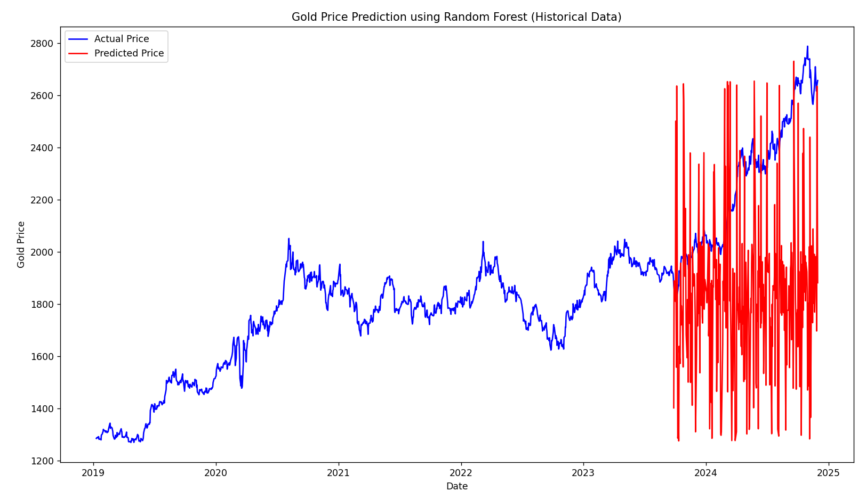

Slide 20
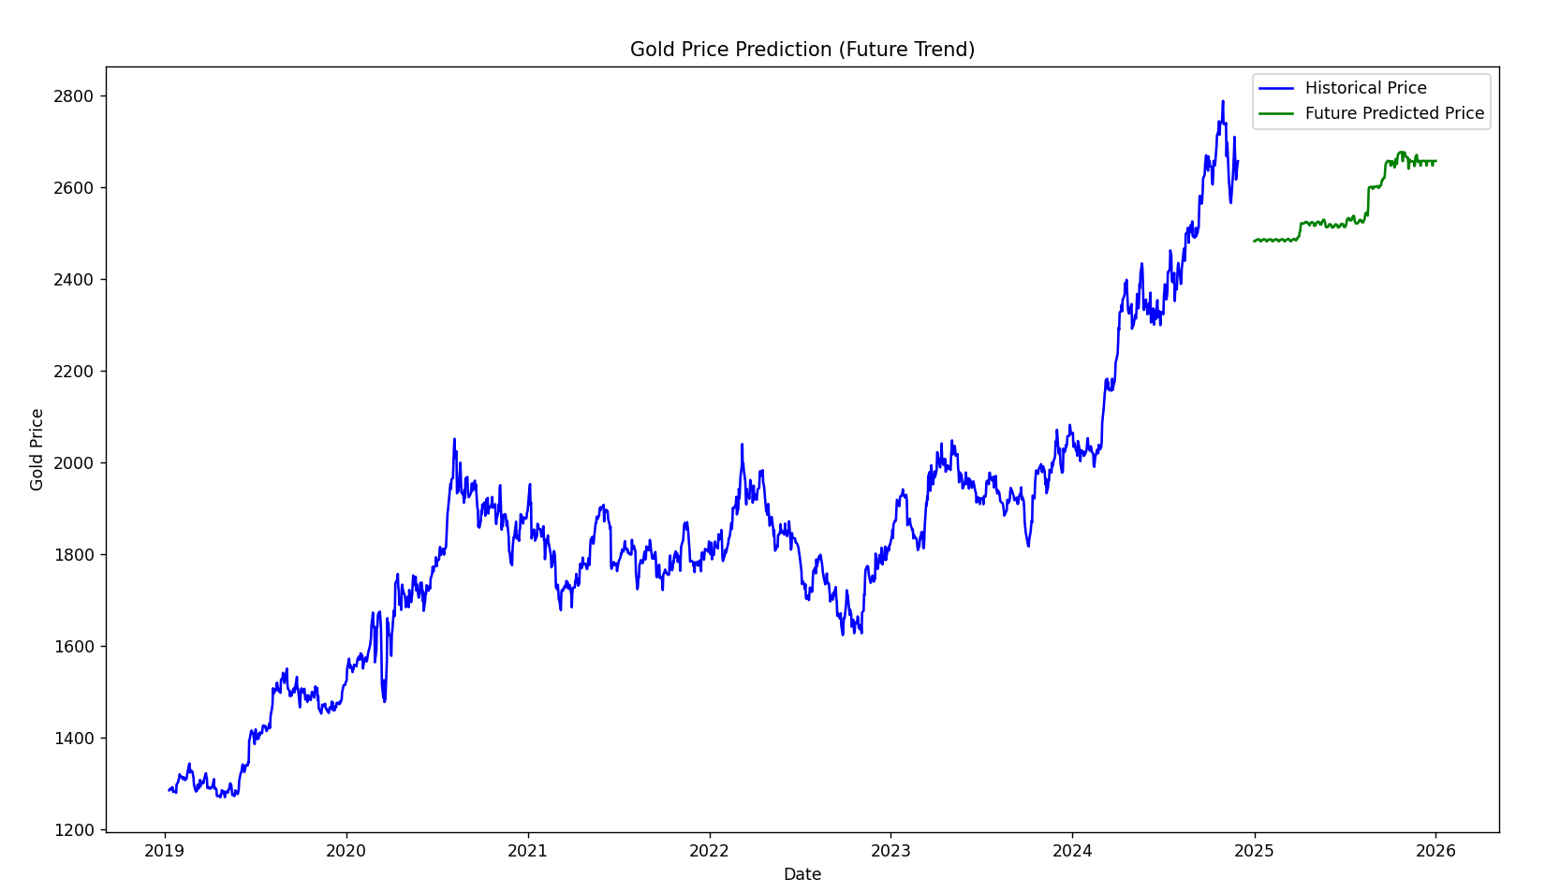

Slide 21
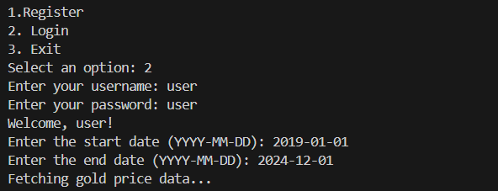
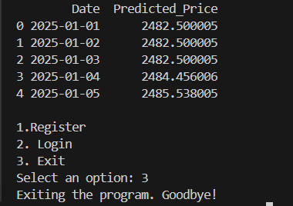

Slide 22
Conclusion

Slide 23
This project serves as an introduction to financial forecasting systems, showcasing the power of machine learning in predicting market trends. With further enhancements, it can evolve into a valuable tool for investors and analysts seeking data-driven insights into gold price movements.

Slide 24
References
Nandini Tripurana,Binodini Kar, Sujata Chakravarty, Bijay K. Paikaray,Suneeta Satpathy,"Gold Price Prediction using Machine Learning Techniques",Published in International Standard Industrial Classification of All Economic Activities (ISIC),2022.
A Sivasangari,R Deepa,K Geetha Rani, R Surendran,T Tamilvizhi,"High accurate gold rate prediction using random forest regression algorithm",7th IET Smart Cities Symposium,2023.
Rutuja Mahajan, Pranjal Patil, Deptee Chikmurge, Sunita Barve,"Forecasting Gold Price using Ensemble based Machine Learning Approach",International Conference on Innovative Computing, Intelligent Communication and Smart Electrical Systems (ICSES),2023
Ran Kong,"Machine Learning Models for Gold Price Prediction: A Comparative Analysis and Evaluation",Highlights in Business Economics and Management,2024.
JhansiRani Ganapa,Sudheer Choudari,Madhava rao K,"Gold Price Prediction Using Random Forest Regression",Educational Administration: Theory and Practice,2024.

Slide 25
Thank you

